Slide 1
Plusgrade Presentation
Parisa Khazaei
Software Engineer

Slide 2

Introduction

Slide 3
Problem Statement:
Build an application that calculates the total income tax for a given salary and tax year.
The application will query a mock API to retrieve the necessary tax brackets and rates for the calculation.
The calculated income tax will be based on the provided salary and the marginal tax rates specified in the tax brackets.

Slide 4
Architecture And Design
Microservices architecture
Why : to achieve scalability, modularity, and independent deployment of services.
Microservices :
User Service
Partner Service(tax year Salary)
Tax Calculator Service (Tax Salary)

Slide 5
Technologies and Tools:
Programming Language: Go
Web Framework: Gin
Moc API WireMoc
IDE: Intellij
Testing Framework: Go Testing Package

Slide 6
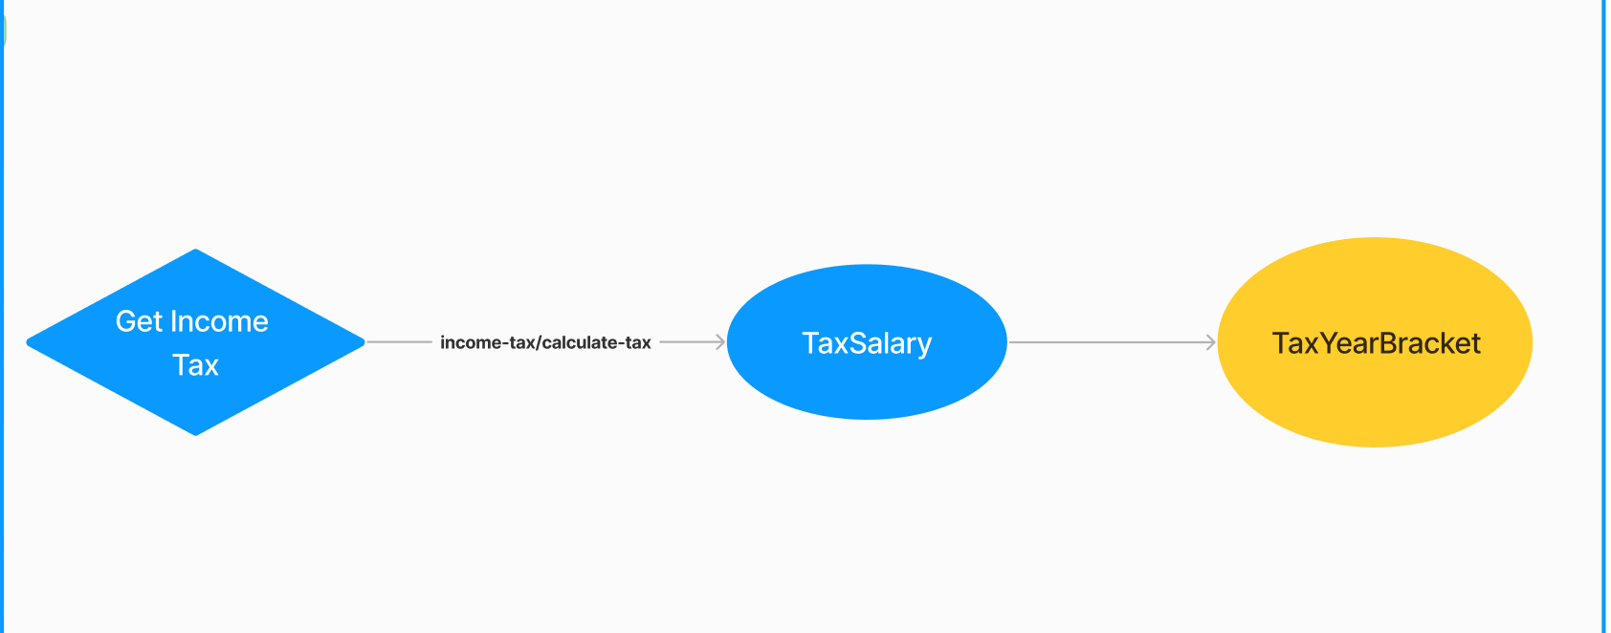
System Overview

Slide 7
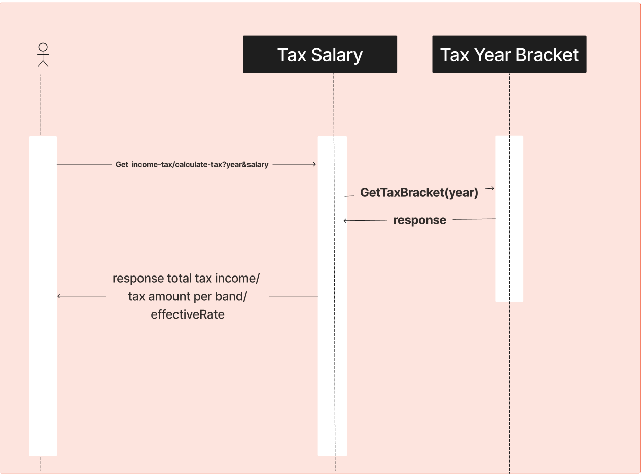
Sequence Diagram

Slide 8
Details / coding
Design Pattern : MVC
Service: Domain Driven Design

Slide 9
Testing

Slide 10
Future Enhancements
Adding GateWay / Authentication
Adding DB to tax calculator service
Adding More APIs to save salary tax income, update it , …
Testing framework : Cucumber / TypeScript
Coding :
adding Interface to each layers ( controller/ service/ Repository)
using go routine and channel to handle concurrent requests. : consider any resource limitations and concurrency control mechanisms to avoid overwhelming the server

